Slide 1
Sub-Saharan Africa Investment Banking Review First Quarter 2023
Refinitiv Deals Intelligence

Slide 2
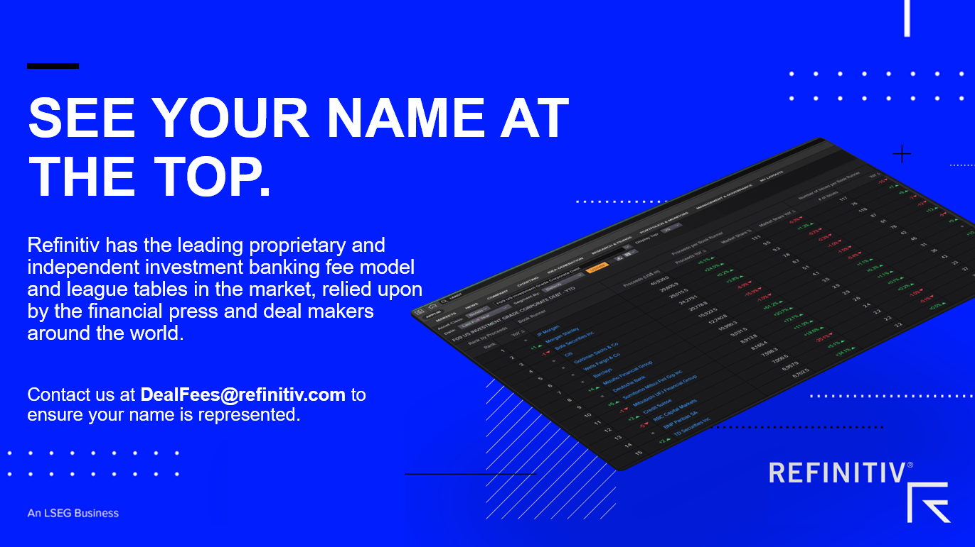
Sub-Saharan Africa Investment Banking Review: Highlights
HIGHLIGHTS

Slide 3
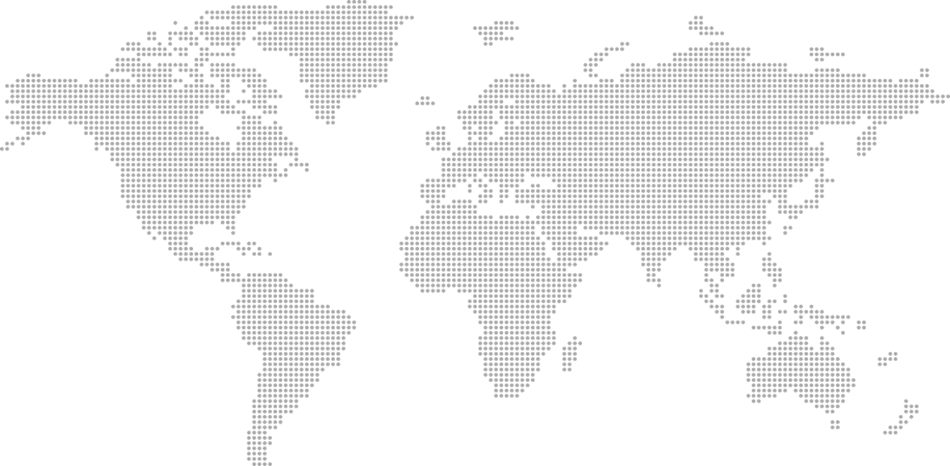
Sub-Saharan Africa Investment Banking Review: Investment Banking Fees
SUB-SAHARAN AFRICAN INVESTMENT BANKING FEES (US$ MIL)
KEY HIGHLIGHTS
An estimated US$64.8 million worth of investment banking fees were generated in Sub-Saharan Africa during the first quarter of 2023, down 50% from the first quarter of 2022 and the lowest first quarter total since 2010. Fees declined 66% compared to the fourth quarter of 2022.
Equity capital markets underwriting fees totalled US$9.6 million, an increase of 9% compared to the first quarter of 2022, which ranked as the slowest first quarter for Sub-Saharan Africa IB fees since 2010. Debt capital markets fees declined 47% to US$23.2 million, while syndicated lending fees declined 15% to a nine-year low of US$18.0 million.
Advisory fees earned from completed M&A transactions in the region reached US$14.0 million during the first quarter of 2023, down 75% from 2022 levels and marking the slowest first quarter for M&A fees in Sub-Saharan Africa since 2005.
Seventy-four percent of all Sub-Saharan African fees were generated in South Africa during the first quarter of 2023, followed by Ivory coast (8%) and Nigeria (5%).
JP Morgan earned the most investment banking fees in the region during the first quarter of 2023, a total of US$14.3 million or a 22% share of the total fee pool.
SUB-SAHARAN AFRICAN IB FEES BY ASSET CLASS, YTD PERIODS (US$ MIL)
REGIONAL INVESTMENT BANKING FEE COMPARISON, YTD WITH YOY % CHANGE
Global
$24.3 billion
-22%
Europe
$5.8 billion
-12%
Japan
$1.1 billion
-4%
MENA
$0.2 billion
-62%
Asia Pacific
$5.9 billion
-26%
Americas
$11.2 billion
-25%
Sub-Saharan Africa
$65 million
-50%

Slide 4
Sub-Saharan Africa Investment Banking Review: Mergers & Acquisitions
ANY SUB-SAHARAN AFRICAN INVOLVEMENT ANNOUNCED M&A VOLUMES
SUB-SAHARAN AFRICAN TARGET M&A BY TARGET SECTOR, YTD (US$ MIL)
SUB-SAHARAN AFRICAN ANNOUNCED M&A VOLUMES, YTD PERIODS (US$ BIL)
KEY HIGHLIGHTS
The value of announced M&A transactions with any Sub-Saharan African involvement reached US$2.9 billion during the first quarter of 2023, an 80% decline compared to first quarter 2022 and the lowest first quarter total since 2003. The number of Sub-Saharan African deals declined 30% compared to a year ago, a nine-year low.
Deals involving a Sub-Saharan African target totalled US$2.3 billion during the first quarter of 2022, down 81% from 2022 levels and a three-year low. The number of deals declined 28% from last year. Inbound deals involving a non-Sub-Saharan African acquiror declined 85% to US$1.5 billion, while domestic deals declined 64% to US$838.6 million. Sub-Saharan African outbound M&A totalled US$384.1 million, down 53% compared to the value recorded during 2022 and a nine-year low.
Materials deal making totalled US$699.4 million, or 30% of first quarter 2023 Sub-Saharan African involvement M&A activity, an increase of 34% compared to a year ago. Energy & Power and Consumer Products & Services rounded out the top three sectors for first quarter 2023 M&A activity. Nigeria was the most targeted nation, followed by Zimbabwe and South Africa.
Java Capital (Proprietary) Ltd topped the any Sub-Saharan African involvement announced M&A financial advisor league table during the first quarter of 2023.

Slide 5
Sub-Saharan Africa Investment Banking Review: Mergers & Acquisitions
SUB-SAHARAN AFRICAN TARGET M&A BY TARGET NATION, YTD (US$ MIL)
TOP DEALS WITH SUB-SAHARAN AFRICA INVOLVEMENT, YTD

Slide 6
Sub-Saharan Africa Investment Banking Review: Equity Capital Markets
SUB-SAHARAN AFRICAN EQUITY ISSUANCE (US$ BIL)
KEY HIGHLIGHTS
Sub-Saharan African equity and equity-related issuance totalled US$276.2 million during the first quarter of 2023, a 44% decline compared to the same period in 2022. Just one issue was recorded in the region, equalling first quarter 2021’s deal count, the lowest first quarter tally in more than two decades.
South African retail firm Pepkor Holdings was the only company in the region to raise new equity funds during the first quarter of 2023, with its follow-on offering raising US$276.2 million. No initial public offerings or convertible bonds were recorded.
Morgan Stanley and Capitalmind Investec shared first place in the Sub-Saharan African ECM underwriting league table during the first quarter of 2023.
SUB-SAHARAN AFRICAN EQUITY ISSUANCE BY ISSUE TYPE, YTD PERIODS (US$ BIL)
LARGEST SUB-SAHARAN AFRICA DEALS, YTD

Slide 7
Sub-Saharan Africa Investment Banking Review: Debt Capital Markets
SUB-SAHARAN AFRICAN BOND ISSUANCE (US$ BIL)
KEY HIGHLIGHTS
Overall Sub-Saharan African debt capital markets activity totalled US$3.8 billion during the first quarter of 2023, down 66% compared to first quarter 2022 and the weakest opening period for DCM activity in the region since 2016.
A total of 13 new offerings were brought to market in the first quarter of 2023, a 41% decline compared to a year ago and a four-year low.
Ivory Coast was the most active issuer nation during the first quarter of 2023, accounting for 65% of total bond proceeds, followed by South Africa (32%).
Government & Agency issuers accounted for 65% of proceeds raised during first quarter 2023, while Industrials issuance accounts for 26%.
JP Morgan took the top spot in the Sub-Saharan African bond bookrunner ranking during the first quarter of 2023, with US$831.5 million of related proceeds, or a 22% market share.
SUB-SAHARAN AFRICAN BONDS BY ISSUER TYPE (US$ BIL)
LARGEST SUB-SAHARAN AFRICA DEALS, YTD

Slide 8
Sub-Saharan Africa Investment Banking Review: League Tables
SUB-SAHARAN AFRICAN INVESTMENT BANKING FEES
ANNOUNCED ANY SUB-SAHARAN AFRICAN INVOLVEMENT M&A
SUB-SAHARAN AFRICAN EQUITY & EQUITY RELATED
SUB-SAHARAN AFRICAN DEBT

Slide 10
Sub-Saharan Africa Investment Banking Review: Contacts & Criteria
CONTACT US
AMERICAS:
Matthew Toole
+1 646 223 7212
matthew.toole@refinitiv.com
EMEA:
Lucille Jones
+44 207 542 4372
lucille.jones@refinitiv.com
ASIA PACIFIC:
Elaine Tan
+632 459 1567
elaine.tan@refinitiv.com
ABOUT REFINITIV
Refinitiv, an LSEG (London Stock Exchange Group) business, is one of the world’s largest providers of financial markets data and infrastructure. With $6.25 billion in revenue, over 40,000 customers and 400,000 end users across 190 countries, Refinitiv is powering participants across the global financial marketplace. We provide information, insights, and technology that enable customers to execute critical investing, trading and risk decisions with confidence. By combining a unique open platform with best-in-class data and expertise, we connect people to choice and opportunity – driving performance, innovation and growth for our customers and partners.
Now, as part of LSEG we are underpinned by the strength and stability of a more than 300-year-old organisation, broadening our capacity to positively impact the financial community —be it in trading and banking, investment, wealth, customer and third-party risk, and enterprise data solutions. For more information, go to www.refinitiv.com.
ABOUT DEALS INTELLIGENCE
Refinitiv Deals Intelligence, a part of LSEG's Data & Analytics division, brings up to the minute market intelligence to the deal making community and the financial media through a variety of research reports including Daily Deals Insight, weekly Investment Banking Scorecard, monthly Deals Snapshots and our industry-leading quarterly reviews highlighting trends in M&A and Capital Markets. For more insights, go to www.refinitiv.com/dealsintelligence
While Refinitiv has used reasonable endeavours to ensure that the information provided in this document is accurate and up to date as at the time of issue, neither Refinitiv nor its third-party content providers shall be liable for any errors, inaccuracies or delays in the information, nor for any actions taken in reliance thereon, nor does it endorse any views or opinions of any third party content provider. Refinitiv disclaims all warranties, express or implied, as to the accuracy or completeness of any of the content provided, or as to the fitness of the content for any purpose to the extent permitted by law. The content herein is not appropriate for the purposes of making a decision to carry out a transaction or trade and does not provide any form of advice (investment, tax, legal) amounting to investment advice, nor make any recommendations or solicitations regarding particular financial instruments, investments or products, including the buying or selling of securities. Refinitiv has not undertaken any liability or obligation relating to the purchase or sale of securities for or by any person in connection with this document.
League tables are based on Refinitiv’s standard league table criteria.
© 2020 Refinitiv. All rights reserved.

